Slide 1
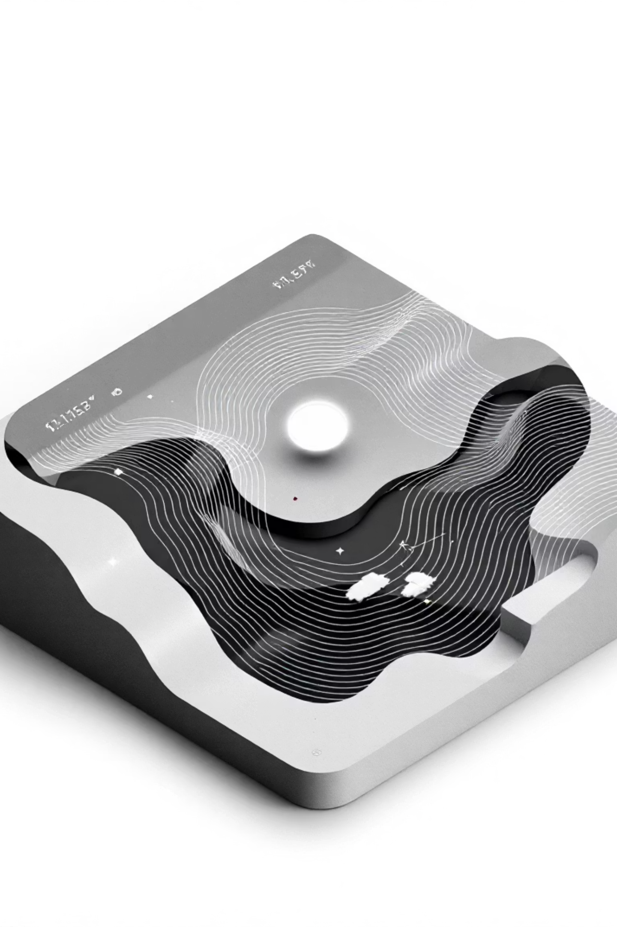
Weather Vibes: NASA Climate Data Made Human
Transforming complex NASA climate science into intuitive "vibe-based" weather discovery for hackathon judges, developers, and UX designers. Created by Team Vibe Finders for the NASA Space Apps Challenge.

Slide 2
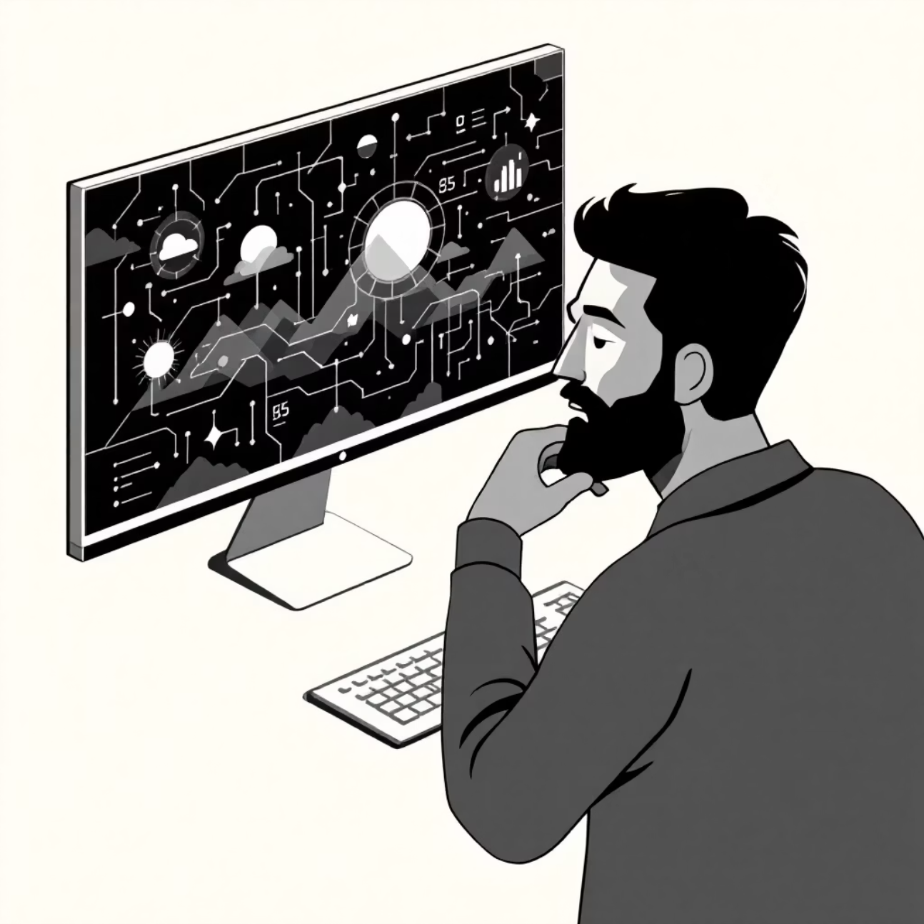
The Problem We're Solving
Traditional weather applications overwhelm users with complex meteorological data, forcing them to interpret charts, graphs, and technical parameters. This creates a significant barrier between human intentions ("I want perfect stargazing conditions") and actionable weather insights.
NASA's POWER API provides decades of rich climate data, yet this treasure trove remains largely inaccessible to everyday users who simply want to know when and where to pursue their favourite activities.
Weather Vibes bridges this gap by translating human desires into data-driven recommendations, making Earth science accessible and actionable for everyone from travel bloggers to farmers.

Slide 3

Our Vision: Vibe-Based Weather Discovery
Human-Centred Design
NASA Data Integration
Users express what they want to do, not which weather parameters they need. "Perfect Stargazing Night" instead of "Low cloud cover, minimal humidity".
Decades of historical climate information processed through our "Vibe Engine" to provide concrete, actionable recommendations backed by science.
Intelligent Recommendations
Advanced algorithms translate subjective experiences into objective data analysis, providing both temporal and geographical guidance.

Slide 4
Core Features: Where, When & Specialised Advisors
01
02
03
The "Where" Feature: Vibe Hotspot Finder
The "When" Feature: Vibe Calendar
Specialised Aura Advisors
Advanced feature providing pre-configured, high-value recommendations including Crop & Farming Advisor for agricultural planning, Climate Mood Predictor for wellness suggestions, and AI Fashion Stylist for weather-appropriate outfit recommendations.
Generates interactive heatmaps answering "Given my vibe and a time, where should I go?" Perfect for travel bloggers seeking misty mountain locations for monsoon photography, or event organisers finding the driest locations for outdoor festivals within a 200km radius.
Creates monthly "vibe score" calendars answering "Given my vibe and location, when should I go?" Ideal for hobbyist astronomers determining optimal stargazing months from their rooftop, or families planning wildlife viewing trips to national parks.

Slide 5



Our Technical Architecture
Weather Vibes is built on a robust, scalable architecture designed to efficiently process complex climate data and deliver intuitive user experiences.
Frontend: User Interface
Backend: Vibe Engine
Data Infrastructure
Crafted with Next.js and React for a dynamic and responsive web application. Mapbox integration provides interactive geographical visualizations for "vibe hotspots."
Our core logic, powered by FastAPI and Python, handles user requests, orchestrates data processing, and translates human intent into actionable climate insights.
We tap into the vast NASA POWER API for historical climate data and utilize AWS S3 for scalable storage of processed information and application assets.

Slide 6




Meet the Team & Our Development Roadmap
Our interdisciplinary team combines expertise in data science, frontend development, and robust backend systems to bring Weather Vibes to life.
Kiran: Data Lead
Bhawesh: Frontend Lead
Vivek: Backend Lead
Architecting data integration from NASA POWER API and refining our "Vibe Engine" algorithms.
Crafting intuitive UI/UX with Next.js & React, integrating Mapbox for dynamic visualizations.
Building scalable FastAPI services, managing AWS S3 for data storage, and API endpoints.
Our Agile Development Approach
We follow an agile methodology, prioritizing continuous delivery and iterative improvements across key phases.
Ideation & Planning
Defining user stories and technical specifications.
Core Engine Build
Developing the Vibe Engine's primary logic and data pipelines.
UI/UX Implementation
Bringing the user interface and interactive maps to life.
Testing & Refinement
Gathering feedback, iterating, and optimizing performance.
Deployment & Growth
Launching the platform and planning future feature expansions.

Slide 7

Impact & Innovation: Making Earth Science Accessible
40+
3
∞
NASA Parameters
Core Features
Possibilities
Decades of climate data translated into human-friendly recommendations
Where, When, and Specialised Advisors covering diverse user needs
Extensible vibe dictionary enabling unlimited activity-weather combinations
Weather Vibes represents a paradigm shift in how humans interact with climate data. By transforming NASA's comprehensive Earth science information into intuitive, activity-focused recommendations, we democratise access to decades of meteorological knowledge.
Our innovation lies not merely in technical implementation, but in the fundamental reimagining of weather applications as human-centred tools. Rather than expecting users to become meteorologists, we've made meteorology serve human intentions—creating a bridge between Earth science and everyday life that empowers informed decision-making for everyone from farmers to photographers.

